Slide 1

ENTERPRISE
DESIGN & DEVELOPMENT OF DBMS FOR
- Case Study by
SHARON SAM SIMPSON

Slide 2
Banking Environment
The bank management system is an application for maintaining a person’s account in a bank and further the bank provides loans for its customers
The following presentation provides the specification for the banking enterprise.

Slide 3
Problem Statement
Creating a Banking database application considering the following constraints :
A bank has many branches.
Each branch maintains multiple accounts and offers many loans.
Loans are paid in many Installments.
Customer may hold multiple accounts but atleast one account and can borrow loans from bank.

Slide 4
E-R model of the Banking database
ER diagram is known as Entity-Relationship diagram.
Analyzing the Database to show its structure for finding relationships between entities and their attributes.
Four Steps to construct a E-R Model.

Slide 5
Step 1 − Identify the Entity sets
Bank
Branch
Account
Loan
Installment (Weak Entity)
Customer

Slide 6
Step 2 − Identify the Attributes
Bank − Bank Name, Full Bank Name
Branch − IFSC Code, Branch Name, Branch Address.
Account − Account No, Account Type, Account Balance.
Loan − Loan ID, Loan Type, Loan Amount.
Installment − Installment No, Installment Date, Installment Amount.
Customer − Customer ID, Customer Name, DOB, Age, Phone No, Gender, Address.

Slide 7
Step 3 − Identify the Key attributes
Bank Name is the key attribute for Bank entity.
IFSC Code is the key attribute for Branch entity.
Account No is the key attribute for Account entity.
Loan ID is the key attribute for Loan entity.
Installment No is the key attribute for Installment entity.
Customer ID is the key attribute for Customer entity.

Slide 8
Step 4 − Identify the Relationships, Cardinalities & Participations
Bank has Branches => 1 : N (total)
Branch offer Loans => 1 : N (total)
Installment payment for Loans => M : N (total)
Loan availed by Customer => M : N (partial)
Branch maintain Accounts => 1 : N (total)
Account held by Customers => M : N (total)

Slide 9






E-R Diagram for BANKING ENTERPRISE
IFSC CODE
Branch_Address
­­­­­­­­­­
BANK_NAME
HAS
_{BANK}
BRANCH
Branch_Name
OFFER
MAINTAIN
ACC_BALANCE
LOAN_ID
LOAN PAYMENT
LOAN
AMOUNT
ACCOUNT
ACC_NO
INSTALLMENT_NO
LOAN_TYPE
ACC_TYPE
JOINT
INSTALLMENT
AVAILEDBY
HOLD BY
INSTALLMENT_AMOUNT
CURRENT
SAVINGS
INSTALLMENT_DATE
CUSTOMER
CUST_ID
AGE
CUST_NAME
DOB
ADDRESS
PHONE_NO
GENDER

Slide 10
RDBMS
SQL – Structured Query Language
Oracle Database
SQL Developer

Slide 11
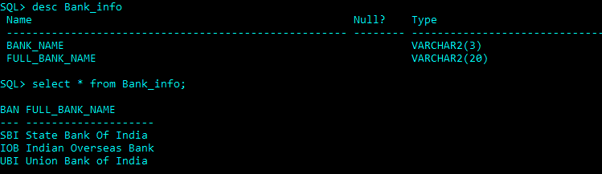
Bank_Info Table

Slide 12
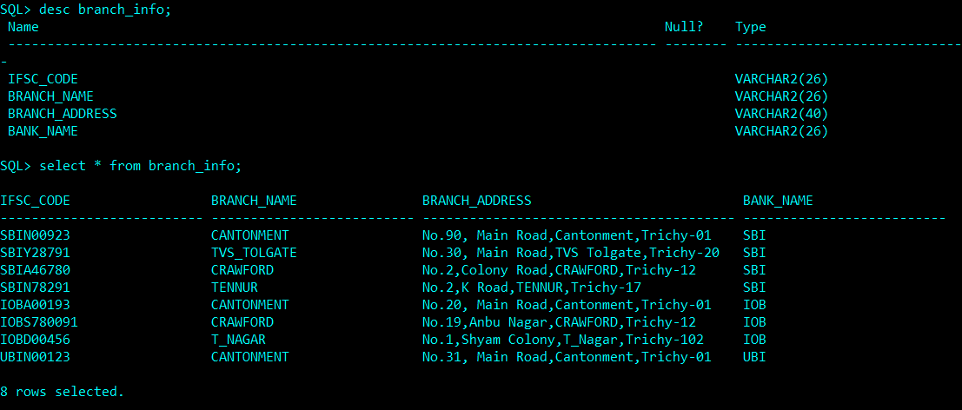
Branch_Info Table

Slide 13
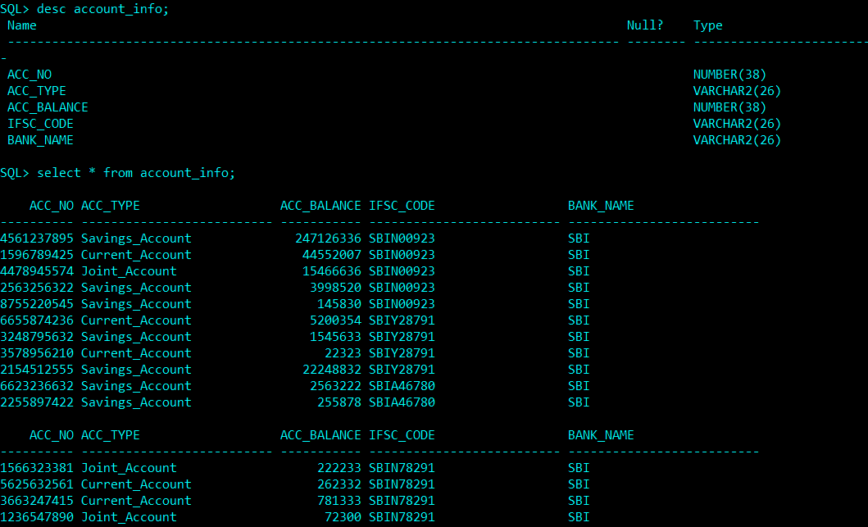
Account_Info Table

Slide 14
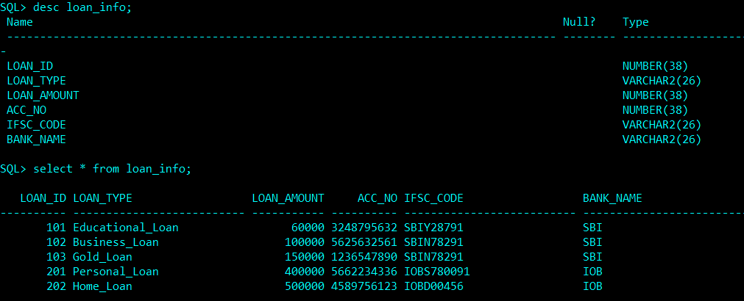
Loan_Info Table

Slide 15
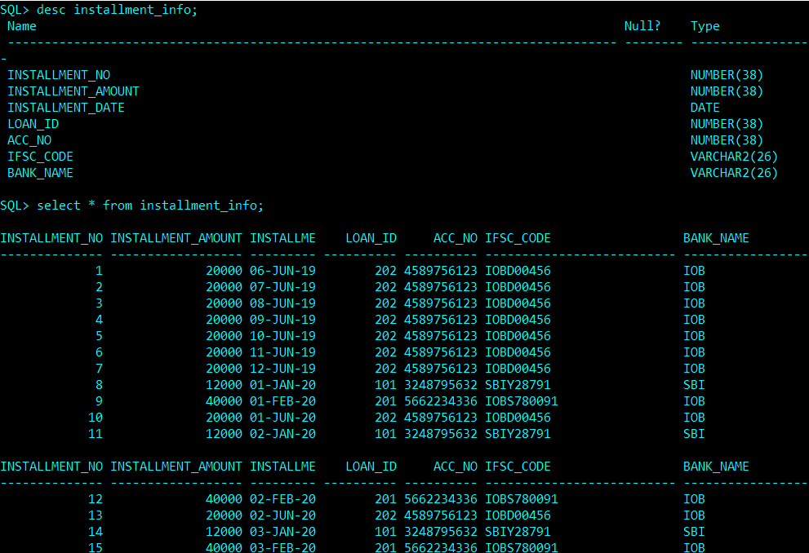
Installment_Info Table

Slide 16
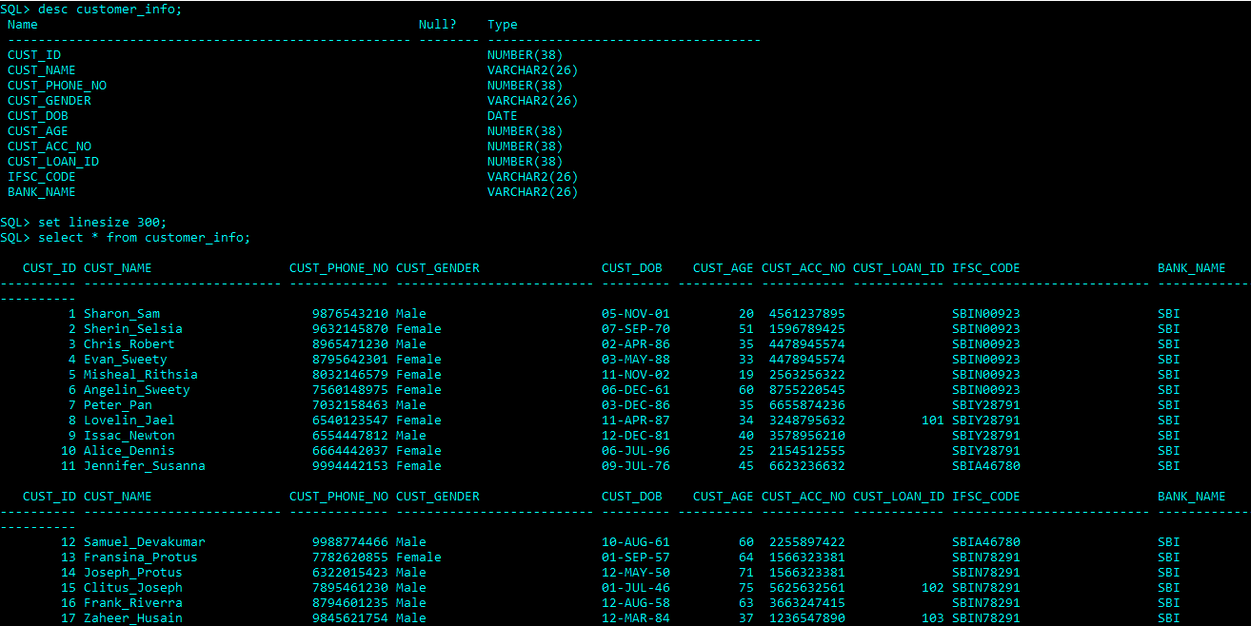
Customer_Info Table

Slide 17
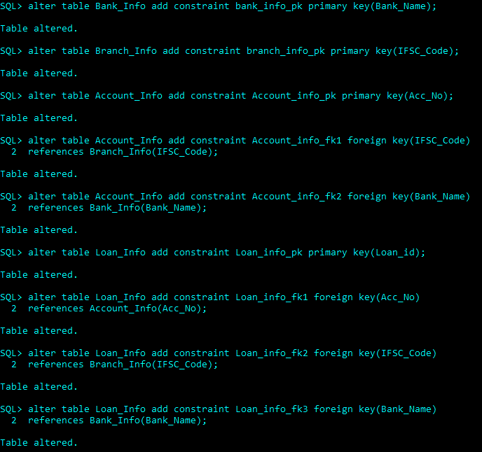
Primary & Foreign keys Constraints

Slide 18
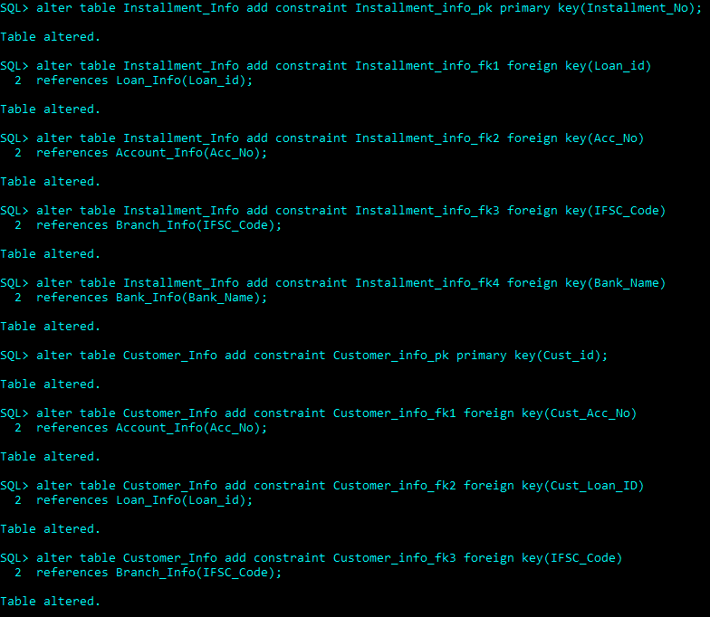
Primary & Foreign keys Constraints

Slide 19
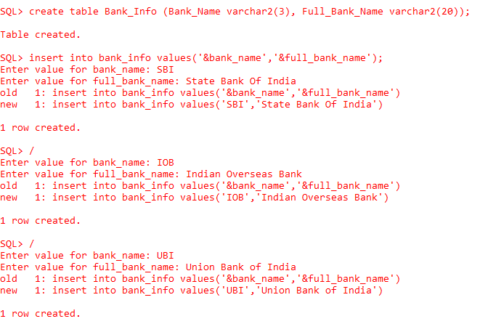
Curd Operations
Creating a table
Inserting values into the table

Slide 20
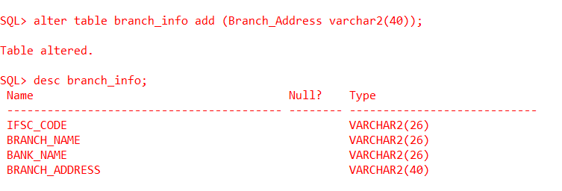
Curd Operations
Adding a column branch address to branch table

Slide 21
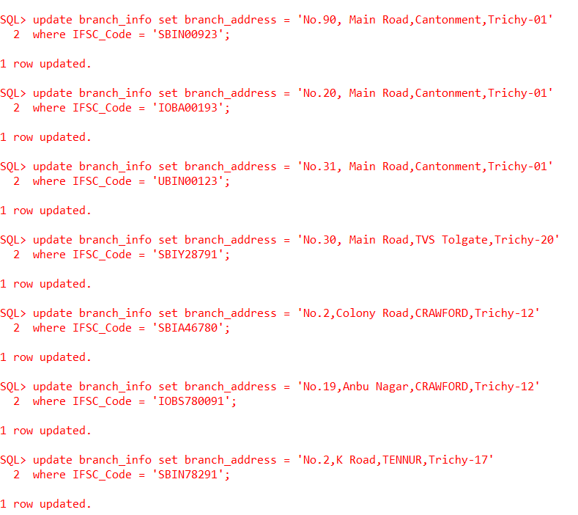
Curd Operations
Updating and populating the column branch address in branch table

Slide 22
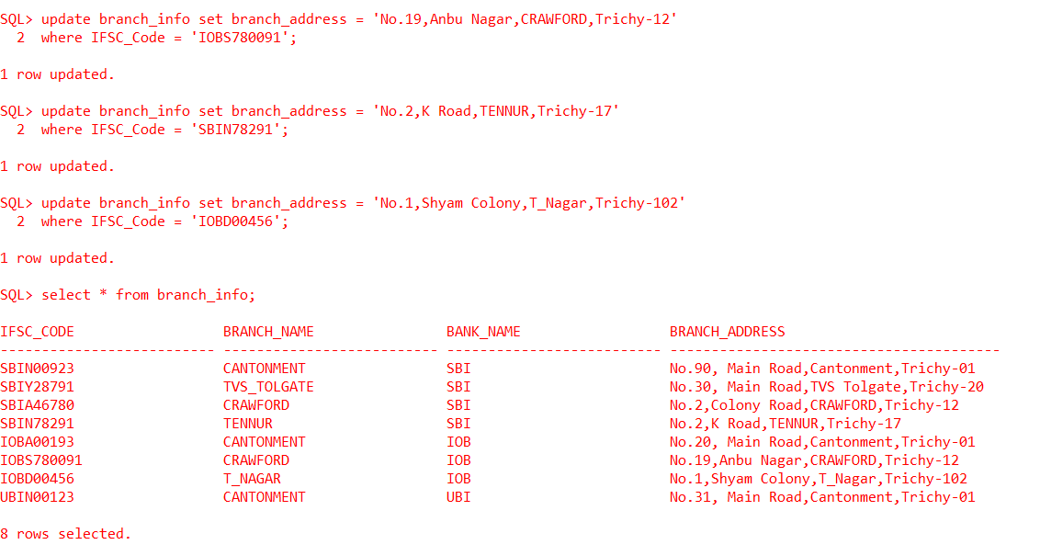
Curd Operations
Reading the entries of the branch info table

Slide 23
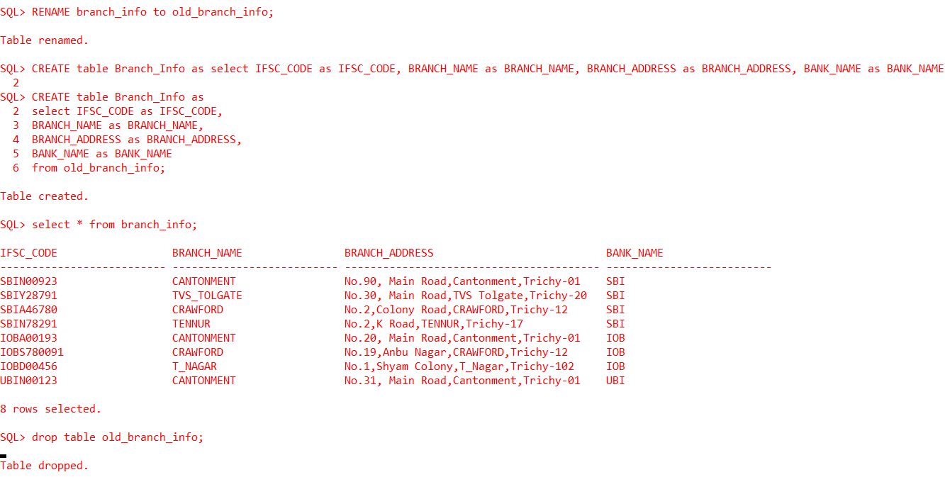
Curd Operations
Changing the Column in a specific position inside a table

Slide 24
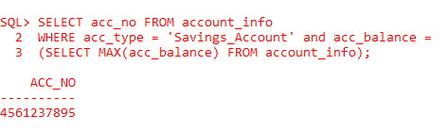
Subquery
Showing the Savings Account which has the highest balance

Slide 25
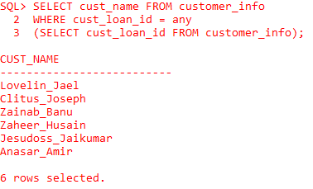
Subquery
Showing the customers who have borrowed loans from bank

Slide 26
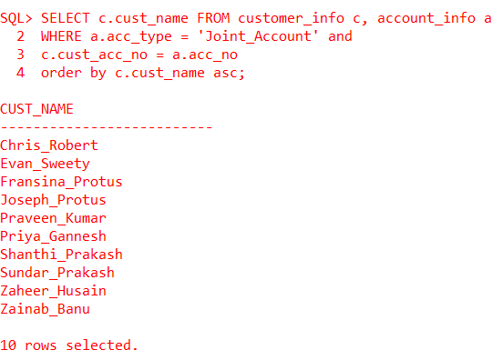
Joins
Showing the customer names who have joint accounts

Slide 27
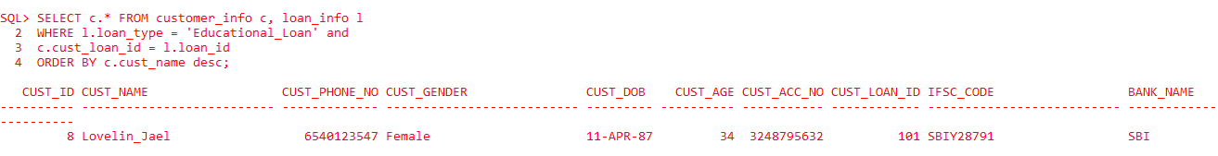
Joins
Showing the details of customer who availed educational loan

Slide 28
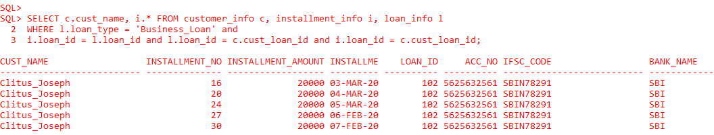
Joins
Showing the installment details of the customer who availed business loan

Slide 29
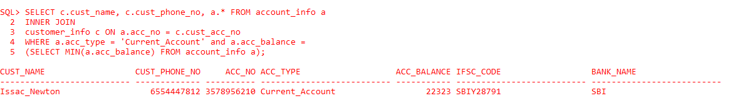
Subquery & Joins
Showing the customer name and phone no and the account details of the customer who has the lowest minimal balance among the current accounts

Slide 30
NoSQL DBMS
NoSQL – Non-Structured Query Language
Non-relational Data Management System
MongoDB

Slide 31
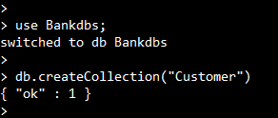
Creating database and Collection
C - Create
U
R
D
Operations

Slide 32
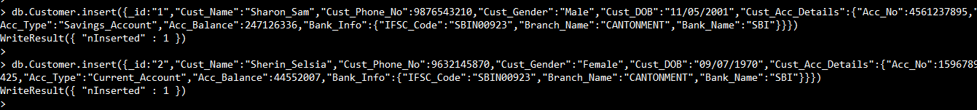
Inserting Documents into Collection

Slide 33
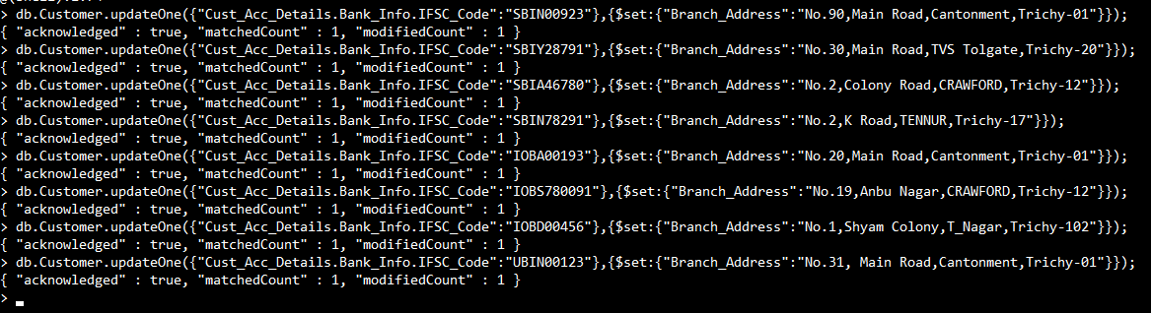
Updating documents
C
U - Update
R
D
Operations

Slide 34
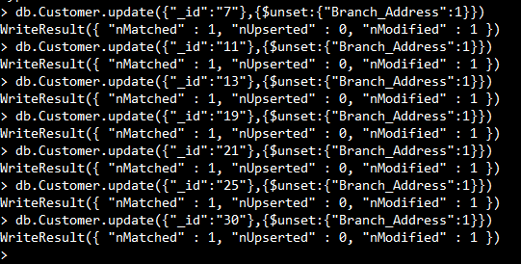
Updating documents
C
U - Update
R
D
Operations

Slide 35
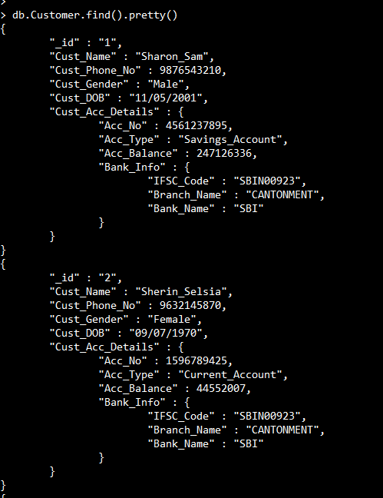
Selecting the documents
C
U
R - Read
D
Operations

Slide 36
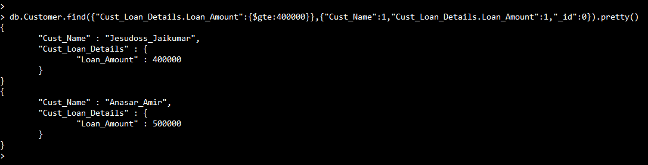
Comparison Operations
Finding the customer name with the loan amount who borrowed from four lakhs

Slide 37
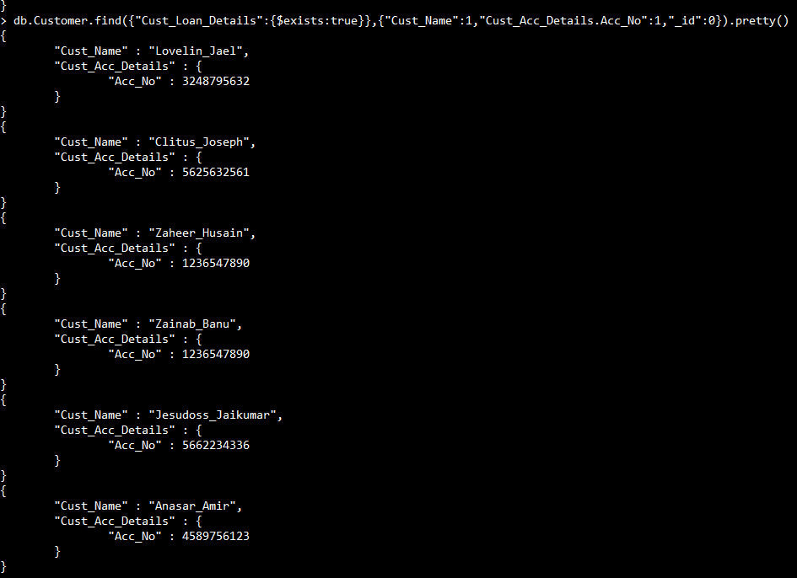
Logical Operations
Finding the customer name with account number for those who availed the loan from bank

Slide 38
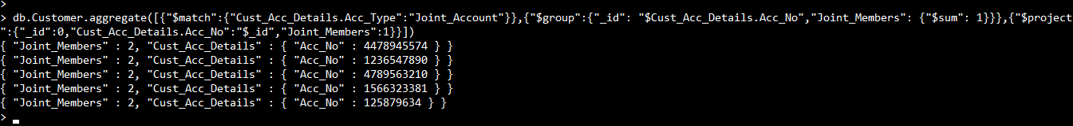
Aggregation
Finding the joint account numbers and count of members in that account

Slide 39

Aggregation
Finding the count of savings and current accounts

Slide 40

Deleting documents
C
U
R
D - Delete
Operations

Slide 41
Graph Database
CQL – Cypher Query Language
Neo4j

Slide 42
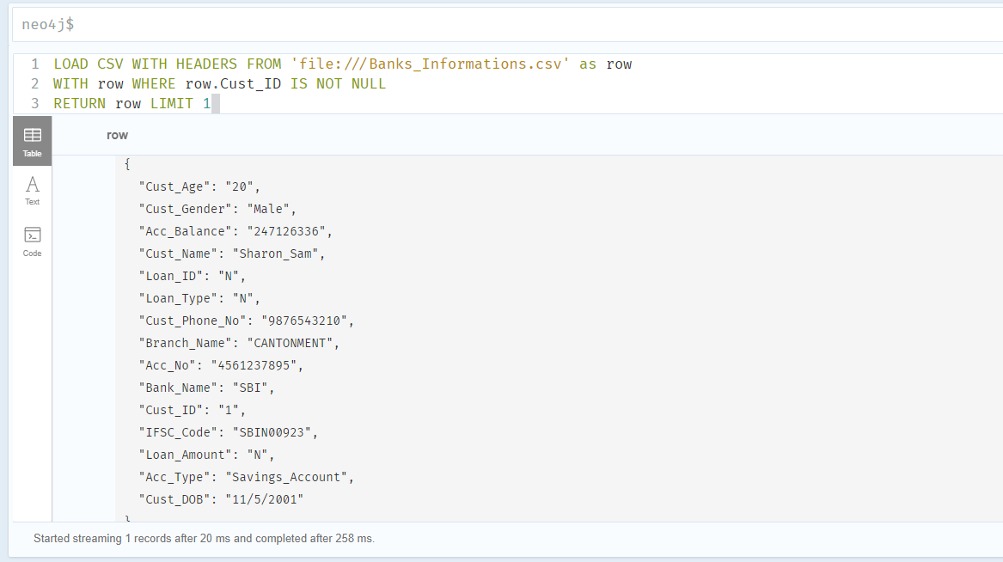
CQL Queries
Importing the csv files into the database and Reading the entries

Slide 43
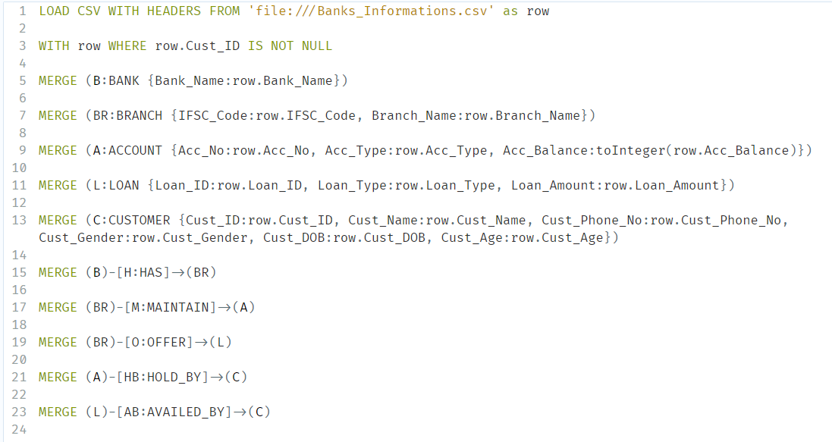
CQL Queries
Creating Nodes and Relationships

Slide 44
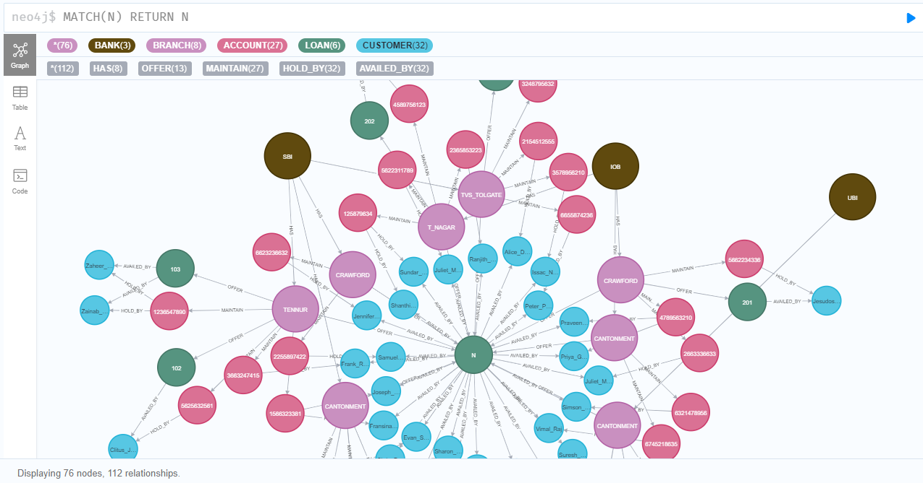
CQL Queries
Retrieving all nodes from the database

Slide 45
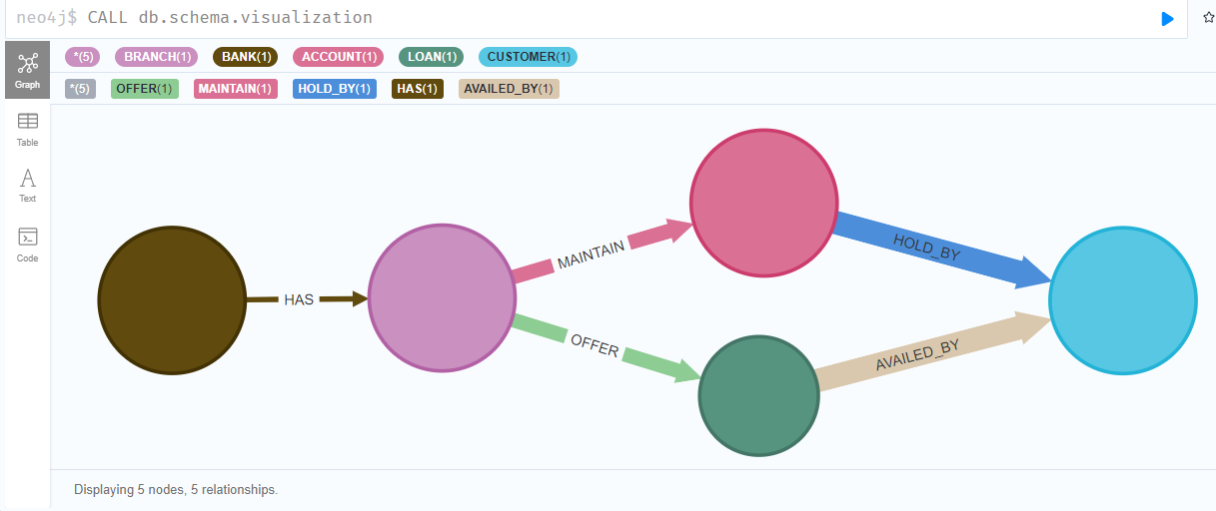
CQL Queries
Showing the schema of the database

Slide 46
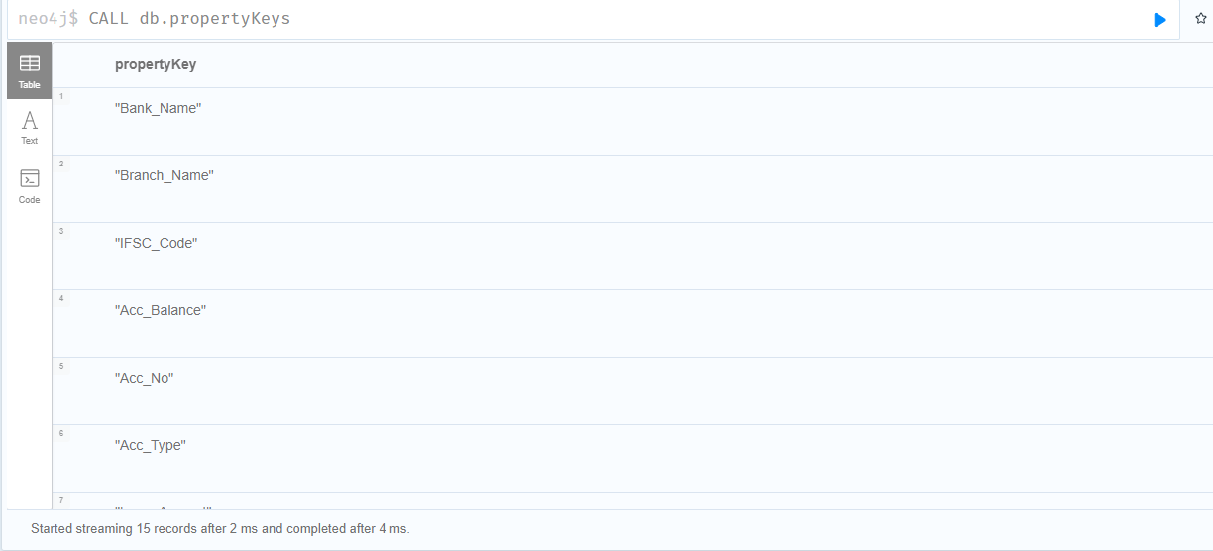
CQL Queries
Showing all the property keys in the database

Slide 47
CONFRONTATIONS
C
H
A
L
L
E
N
G
E
S
Considering the constraints for modeling a DBMS using the E-R diagram
Long tedious process of creating excel files for importing in Oracle environment
Inserting documents in MongoDB environment
Creating relationships for the nodes in Neo4j

Slide 48
MONITOR THE MONEY WITH DBMS…… MERCI…!!!
From Sharon Sam Simpson

